Slide 1

Lesson 02 – Homework review
Well done

Slide 2
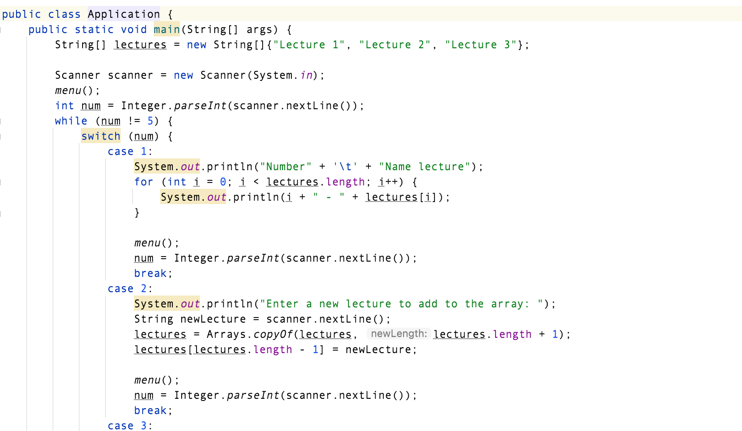
The single-responsibility principle (SRP) is a computer-programming principle that states that every module, class or function in a computer program should have responsibility over a single part of that program’s functionality, and it should encapsulate that part. All of that module, class or function’s services should be narrowly aligned with that responsibility

Slide 3

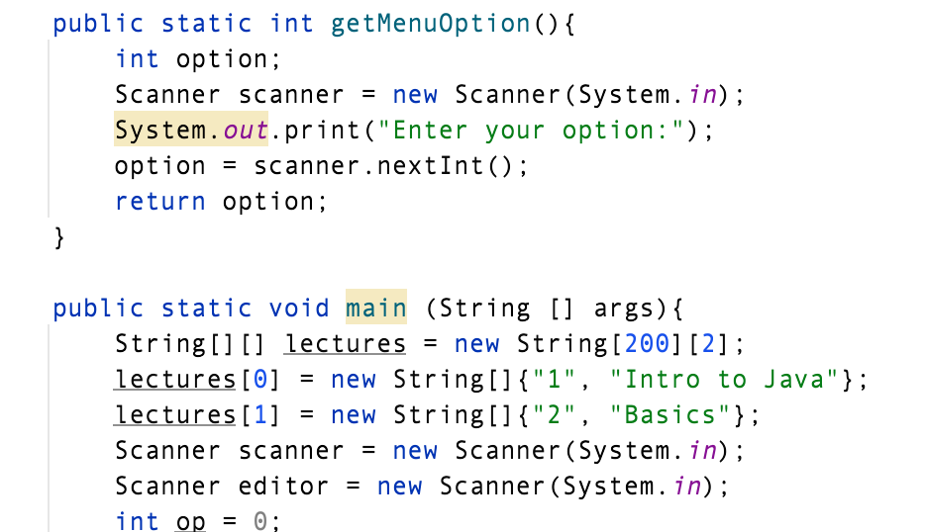

Scanner should be reusable

Slide 4
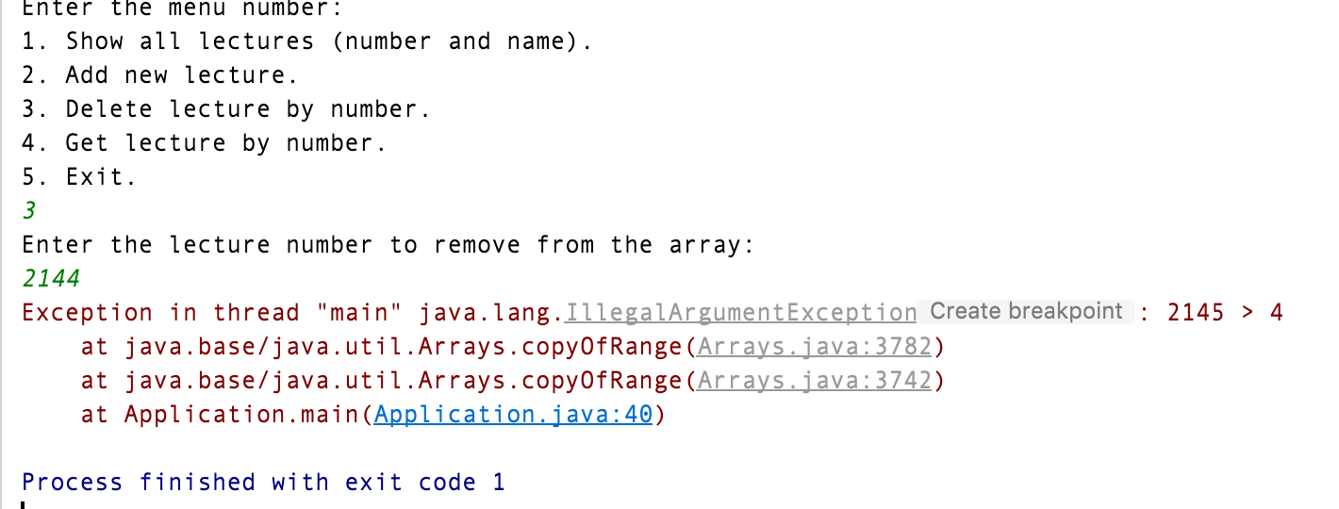
Validation

Slide 5
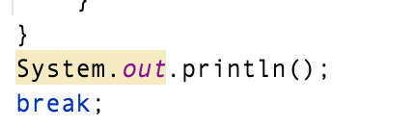


Prefer use system-independent next-line character instead of one more print.
Naming convention

Slide 6


